Slide 1
Day 10 - Greedy Algorithms
Math 495R (Sec 9) - Competitive Coding

Slide 2
Business
Greedy Algorithms Problem Set due Saturday!
Group Blitz on Thursday

Slide 3
Review Dynamic Programming
Abbreviation
Knapsack

Slide 4
Greedy Algorithms
Builds up a solution piece by piece
Finds locally optimal solutions, which may or may not lead up to a global optimum
For NP-Complete problems, often used to find a “good” solution
Efficient Runtimes - O(n), O(nlogn), O(n^2)

Slide 5
Parts to a Greedy Algorithm
Local Scanning / Search (may involve sorting or some other ordering)
Local Optimization
End Condition

Slide 6
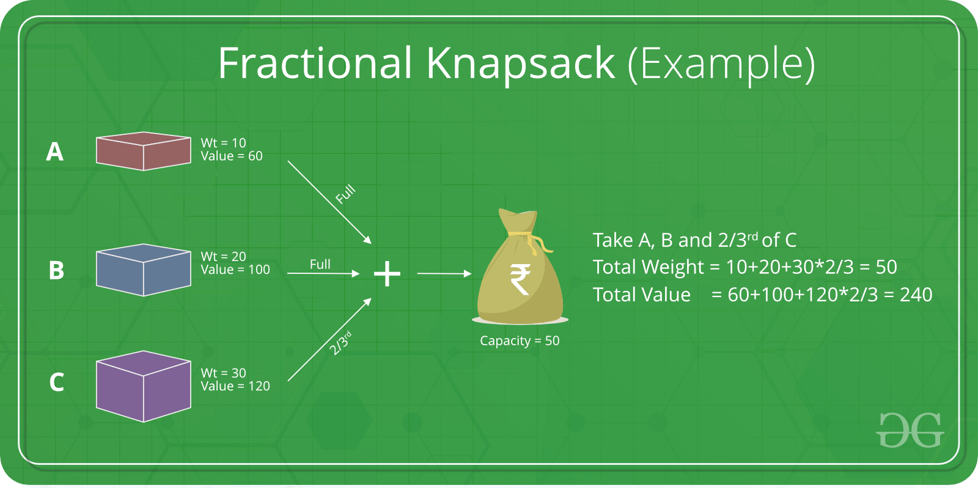
Optimal Examples

Slide 7
Other Optimal Examples
Djikstra’s Algorithm
Huffman Encoding
Minimum Spanning Tree

Slide 8
Non-Optimal Example
Travelling Salesman Problem - Nearest Neighbor

